Slide 1
Bootstrap 4

Slide 2
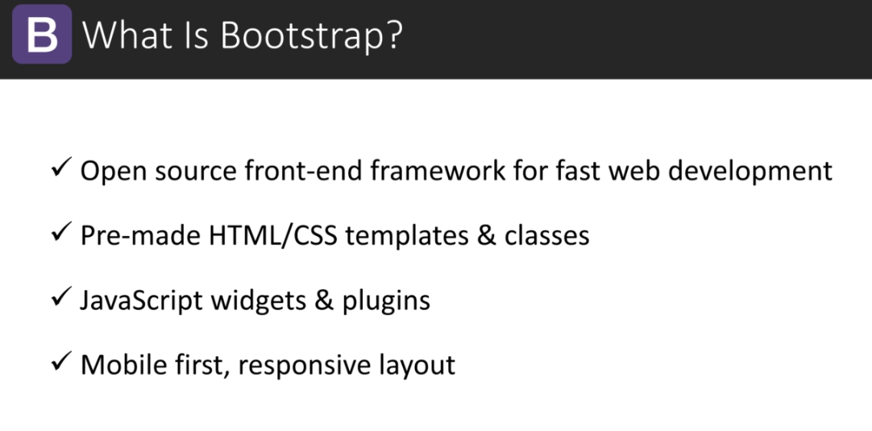

Slide 3
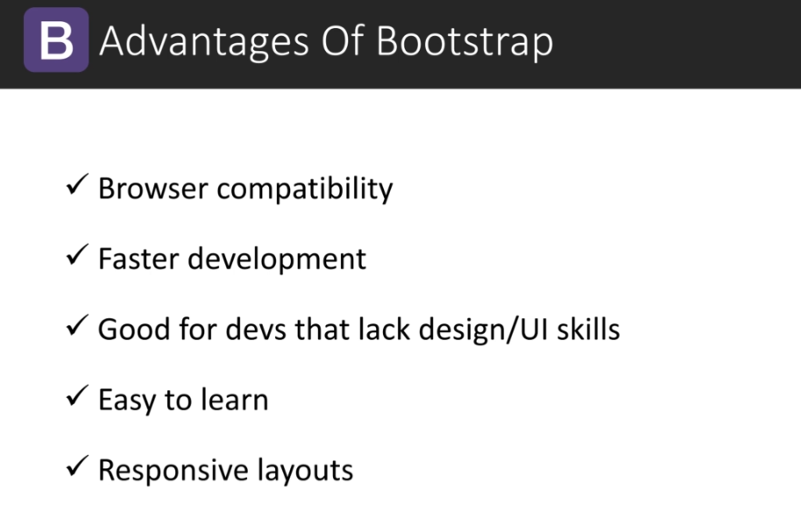

Slide 4
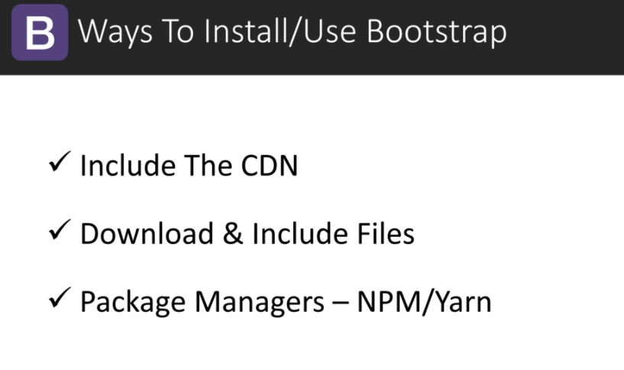

Slide 5
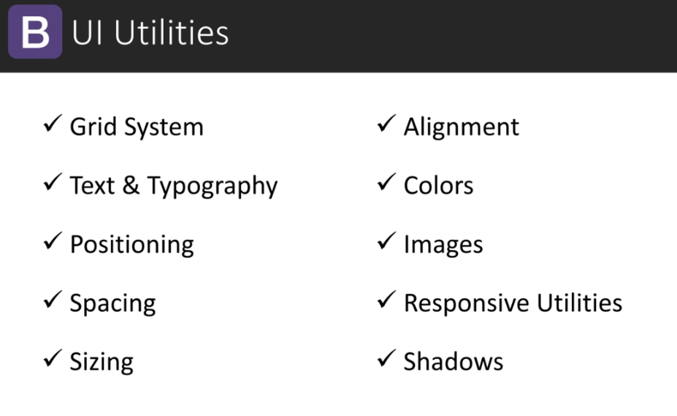

Slide 6
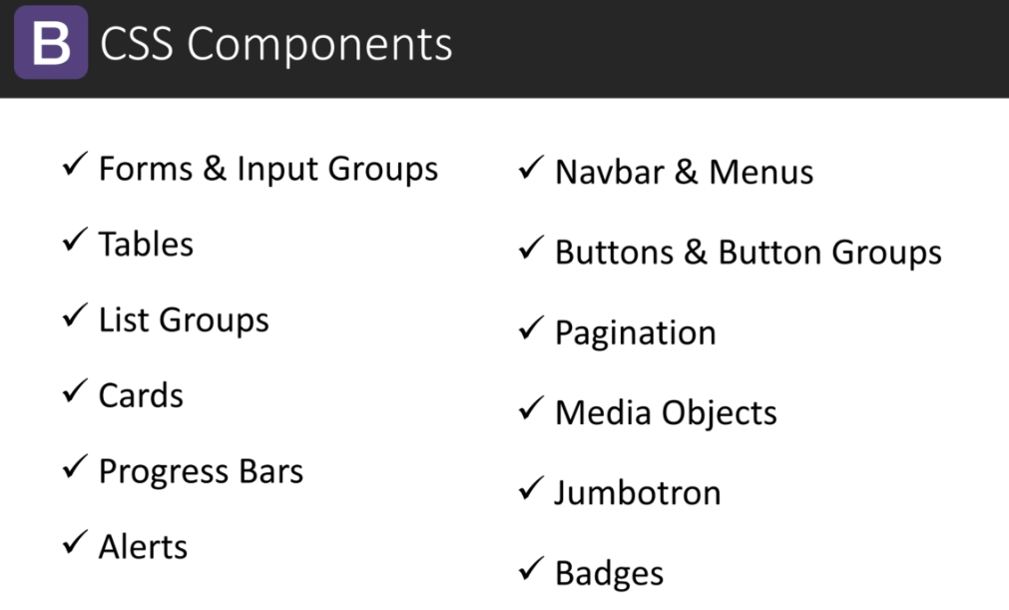

Slide 7
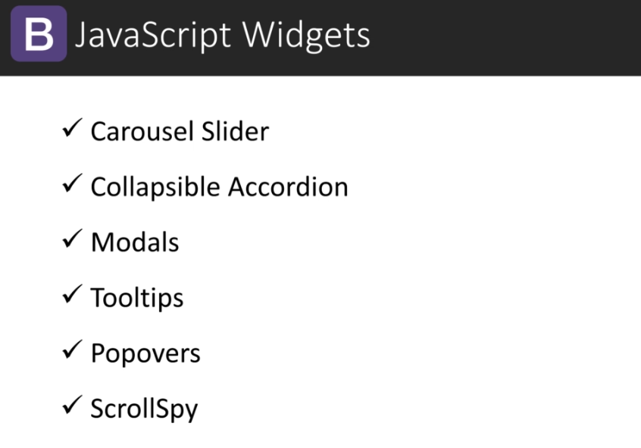

Slide 8
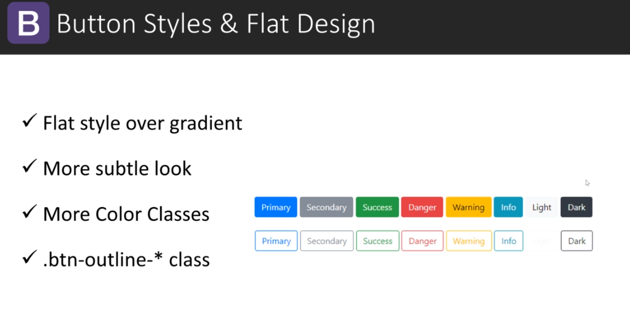
Bootstrap 3 → Bootstrap 4

Slide 9
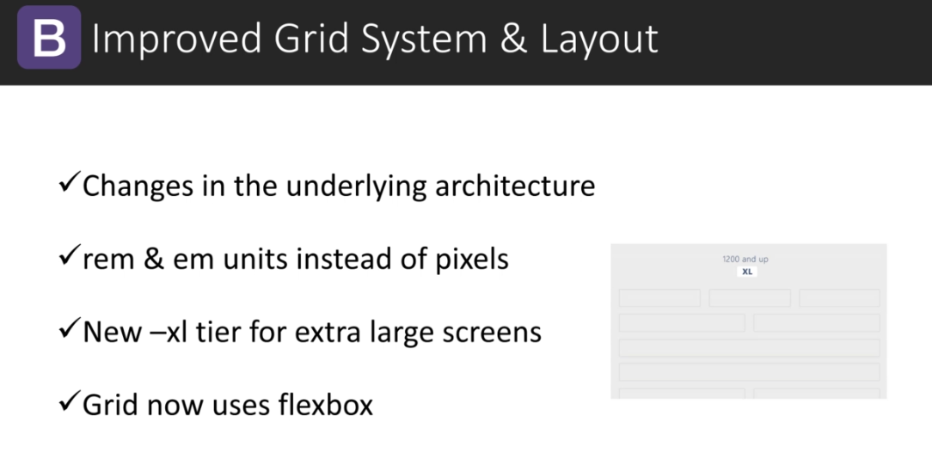
Bootstrap 3 → Bootstrap 4

Slide 10
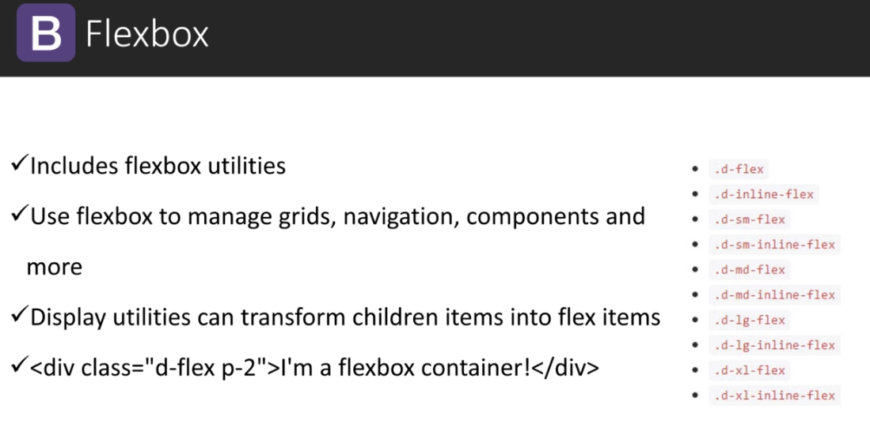
Bootstrap 3 → Bootstrap 4

Slide 11
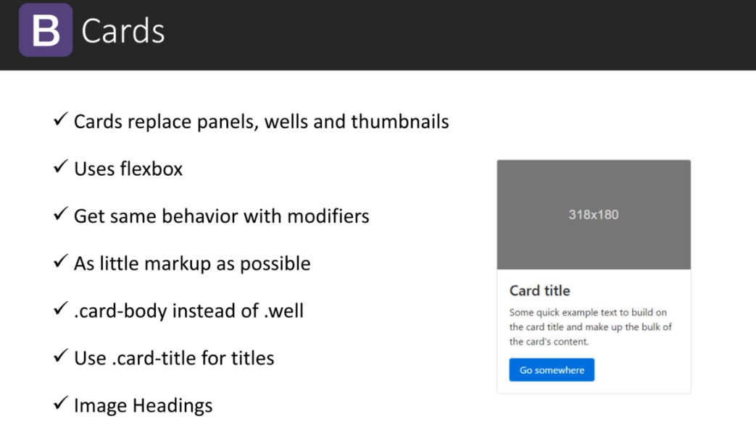
Bootstrap 3 → Bootstrap 4

Slide 12
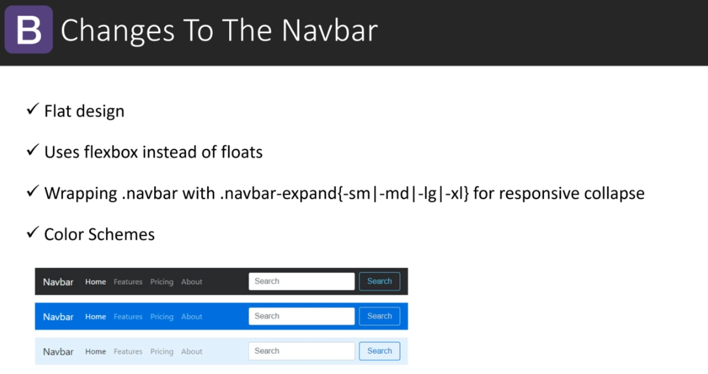
Bootstrap 3 → Bootstrap 4

Slide 13
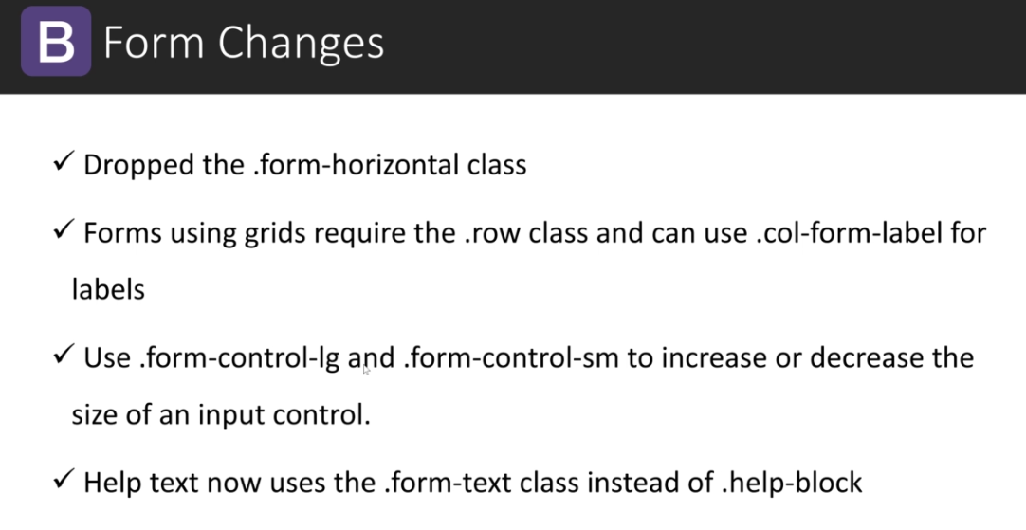
Bootstrap 3 → Bootstrap 4

Slide 14
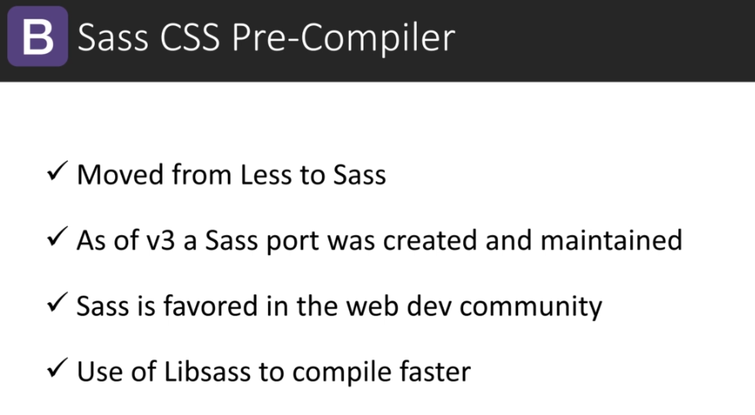
Bootstrap 3 → Bootstrap 4

Slide 15
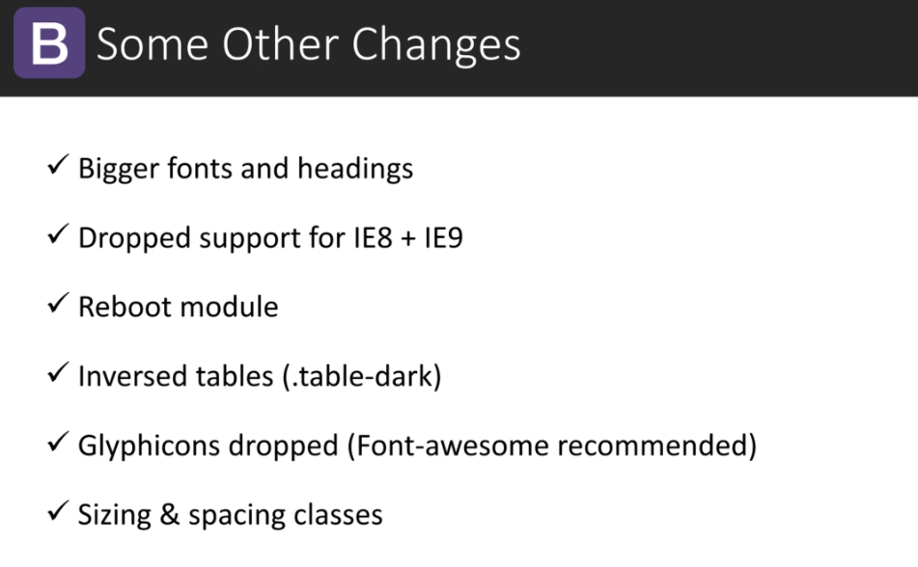
Bootstrap 3 → Bootstrap 4

Slide 16
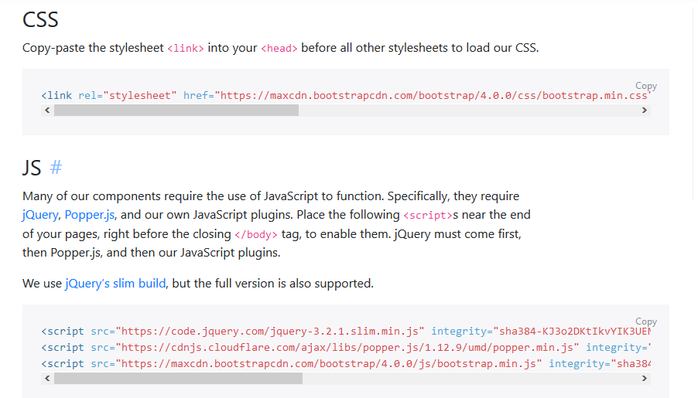
https://getbootstrap.com/docs/4.0/getting-started/introduction/

Slide 17
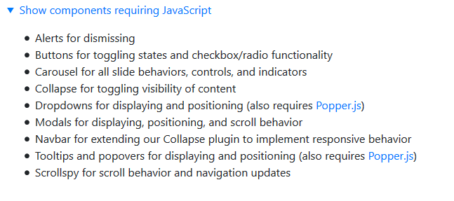

Slide 18
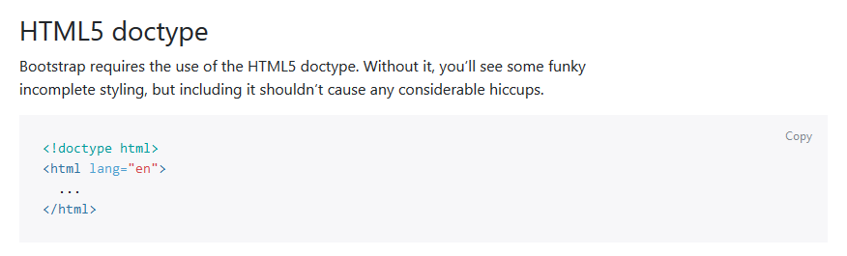
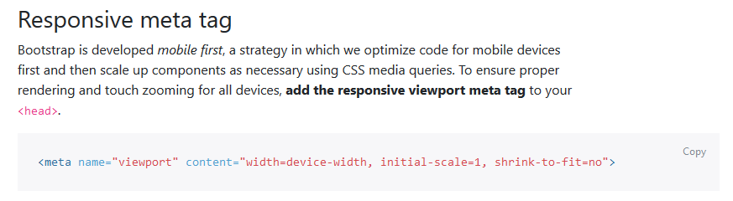

Slide 19
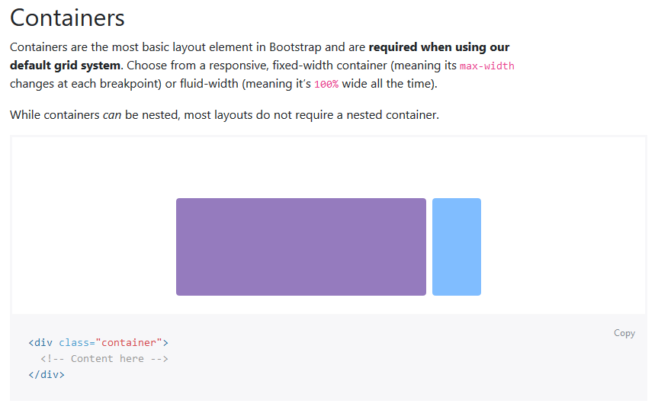

Slide 20
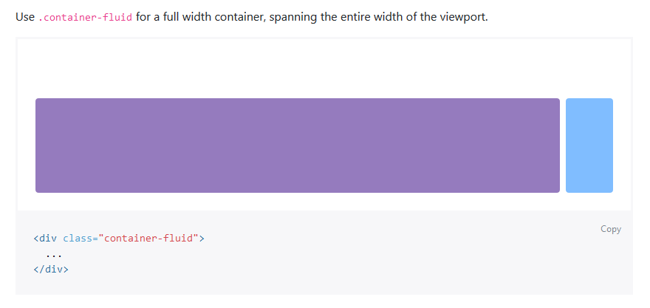

Slide 21
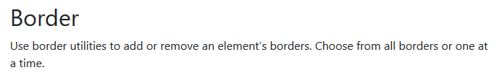

Slide 22
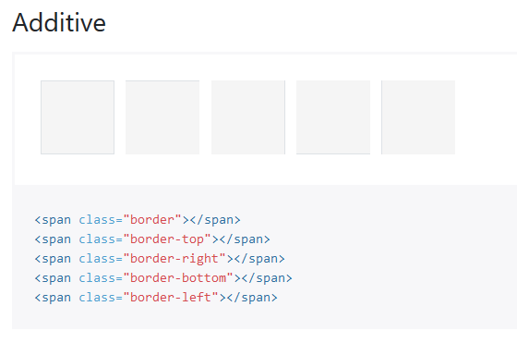

Slide 23
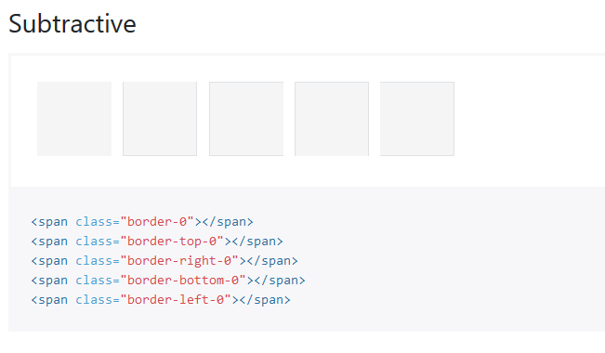

Slide 24
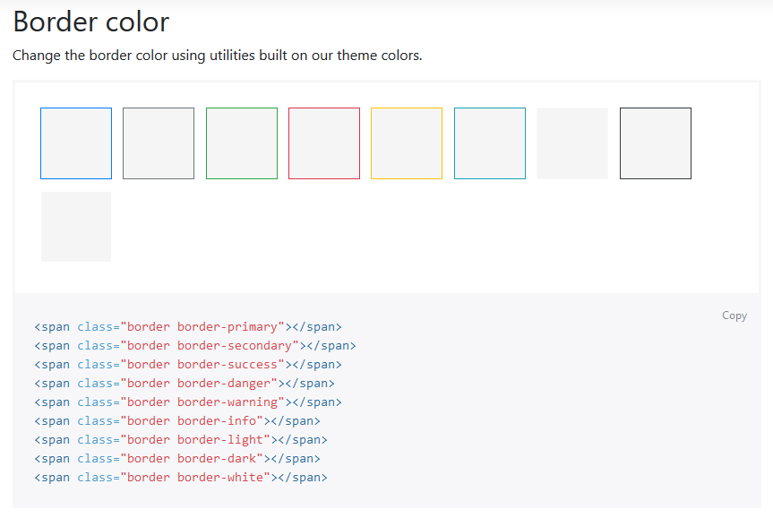

Slide 25
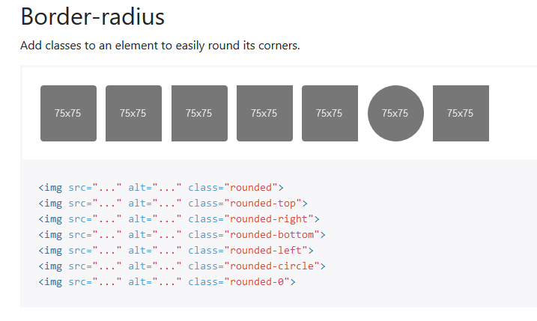

Slide 26
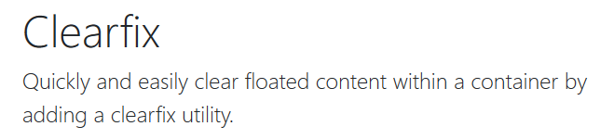
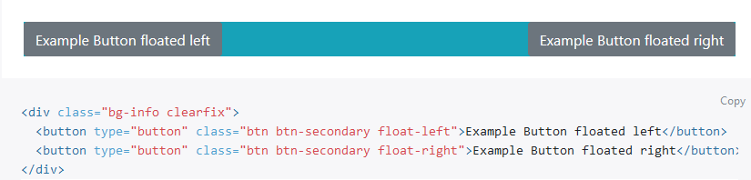

Slide 27
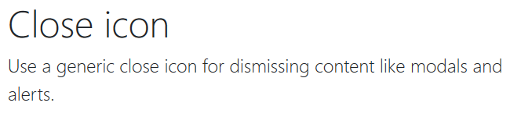
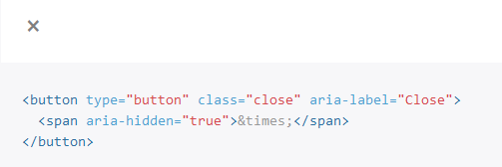

Slide 28
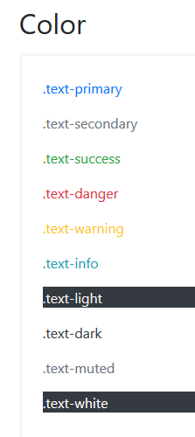
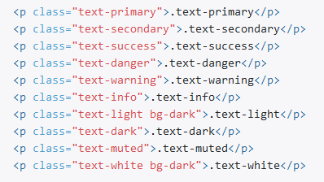

Slide 29
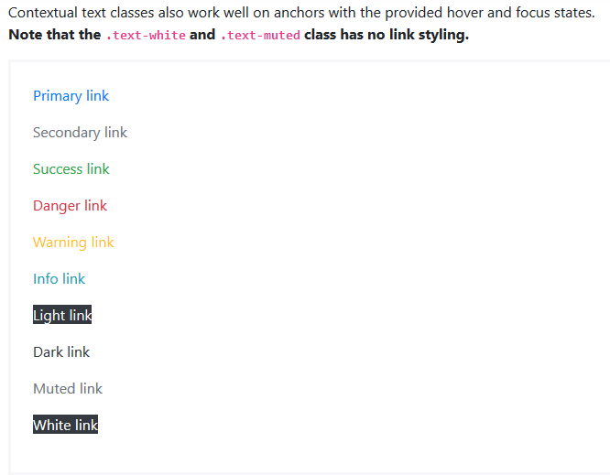
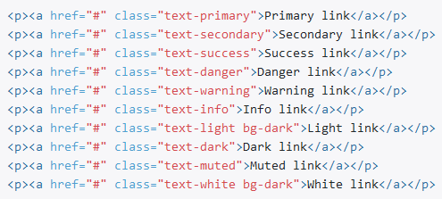

Slide 30
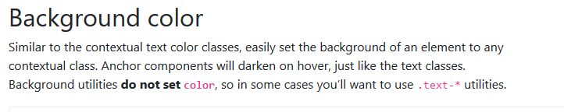

Slide 31
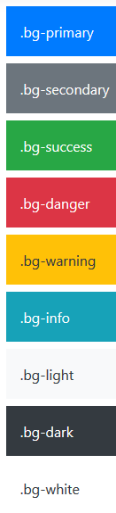
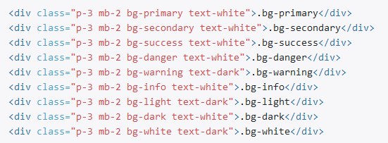

Slide 32
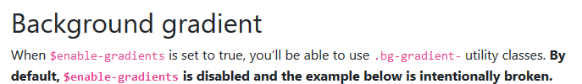
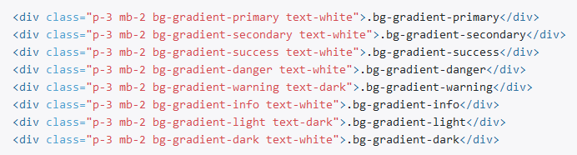

Slide 33
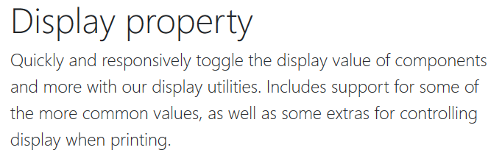

Slide 34
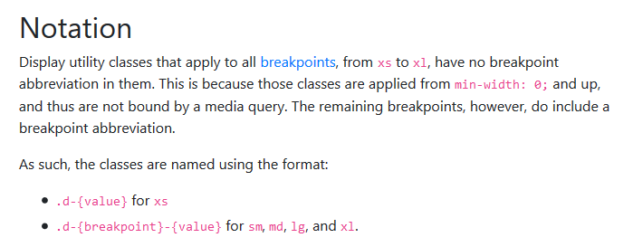
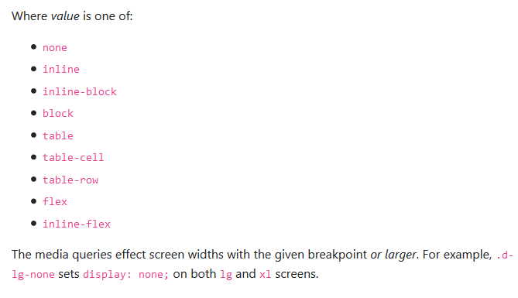

Slide 35
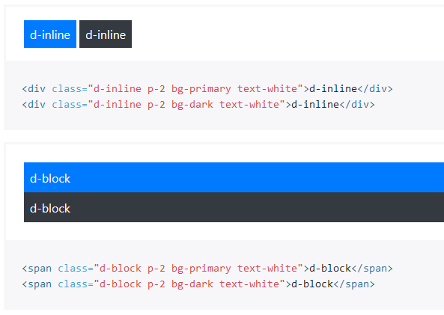

Slide 36
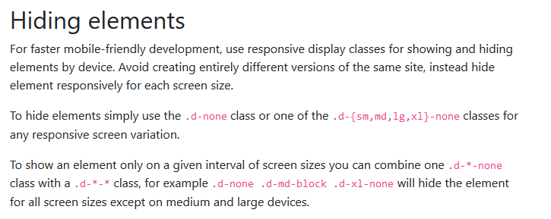

Slide 37
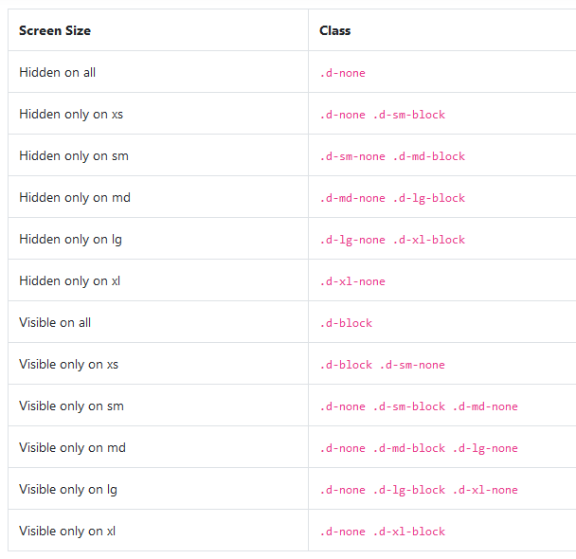

Slide 38
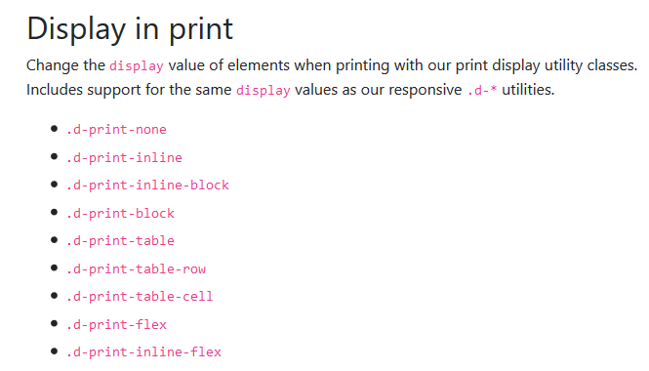

Slide 39
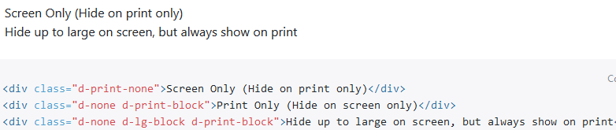

Slide 40
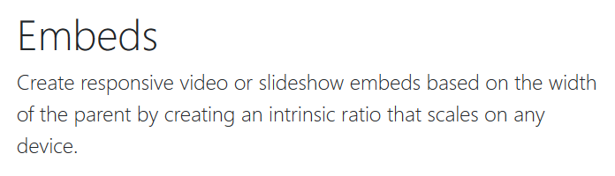

Slide 41

<div class="embed-responsive embed-responsive-16by9">
<iframe class="embed-responsive-item" src="https://www.youtube.com/zpOULjyy-n8" allowfullscreen></iframe>
</div>

Slide 42
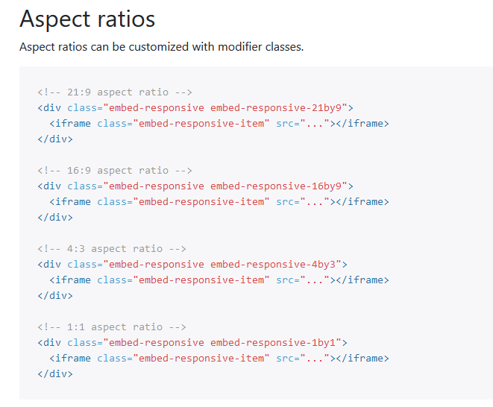

Slide 43
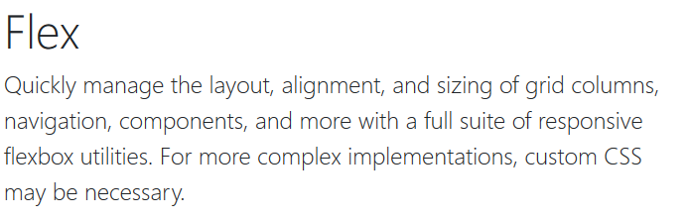
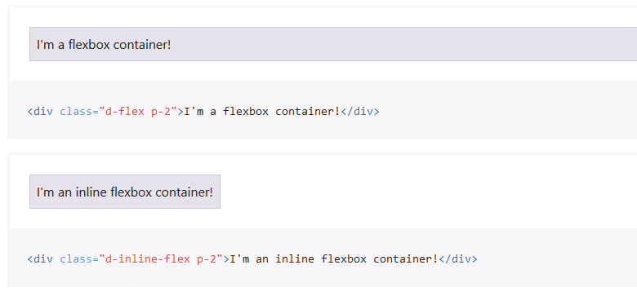

Slide 44


Slide 45


Slide 46


Slide 47



Slide 48


Slide 49



Slide 50




Slide 51



Slide 52




Slide 53



Slide 54


Slide 55


Slide 56


Slide 57


Slide 58


Slide 59


Slide 60


Slide 61


Slide 62


Slide 63






Slide 64


Slide 65



Slide 66



Slide 67


Slide 68



Slide 69



Slide 70


Slide 71



Slide 72



Slide 73



Slide 74



Slide 75


Slide 76



Slide 77




Slide 78



Slide 79


Slide 80


Slide 81


Slide 82


Slide 83



Slide 84


Slide 85



Slide 86



Slide 87



Slide 88


Slide 89


Slide 90


Slide 91


Slide 92


Slide 93



Slide 94


Slide 95



Slide 96



Slide 97


Slide 98



Slide 99


Slide 100


Slide 101



Slide 102


Slide 103



Slide 104


Slide 105


Slide 106


Slide 107


Slide 108


Slide 109


Slide 110


Slide 111


Slide 112


Slide 113


Slide 114



Slide 115



Slide 116



Slide 117



Slide 118



Slide 119



Slide 120



Slide 121



Slide 122


Slide 123



Slide 124



Slide 125



Slide 126


Slide 127



Slide 128


Slide 129


Slide 130


Slide 131



Slide 132


Slide 133



Slide 134


Slide 135


Slide 136



Slide 137



Slide 138


Slide 139


Slide 140


Slide 141



Slide 142



Slide 143



Slide 144



Slide 145



Slide 146



Slide 147



Slide 148



Slide 149



Slide 150


Slide 151


Slide 152


Slide 153


Slide 154


Slide 155


Slide 156


Slide 157


Slide 158


Slide 159


Slide 160


Slide 161



Slide 162


Slide 163


Slide 164



Slide 165



Slide 166


Slide 167


Slide 168


Slide 169



Slide 170


Slide 171



Slide 172



Slide 173



Slide 174



Slide 175



Slide 176



Slide 177


Slide 178



Slide 179



Slide 180



Slide 181



Slide 182



Slide 183



Slide 184



Slide 185



Slide 186



Slide 187



Slide 188



Slide 189



Slide 190


Slide 191


Slide 192


Slide 193


Slide 194


Slide 195



Slide 196



Slide 197



Slide 198



Slide 199




Slide 200


If we touch anywhere else on the screen the popover disappears

Slide 201


Slide 202



Slide 203



Slide 204



Slide 205



Slide 206



Slide 207



